Slide 1
Lecture 5
Understanding Happiness
Happiness is to be in a state of harmony

Slide 2
Content of this Session
Prevailing notions of happiness
Happiness
Continuous happiness
Program for continuity of happiness

Slide 3
Content of this Session इस सत्र कि विषय-वास्तु
Prevailing notions of happiness
Happiness
Continuous happiness
Program for continuity of happiness
सुख के बारे प्रचलित मानताएं
सुख
निरंतर सुख
सुख की निरंतरता के लिए जीने का कार्यक्रम

Slide 4
Happiness = To Be in Harmony
What I Really Want to Be
My Natural Acceptance
My Intention
Always
Relationship
These are in Contradiction
Unhappiness
These are in Harmony
Happiness
Dialogue
What I am
My Desire, Thought, Expectation…
My Competence
Sometimes
Opposition
Sometimes
Relationship

Slide 5
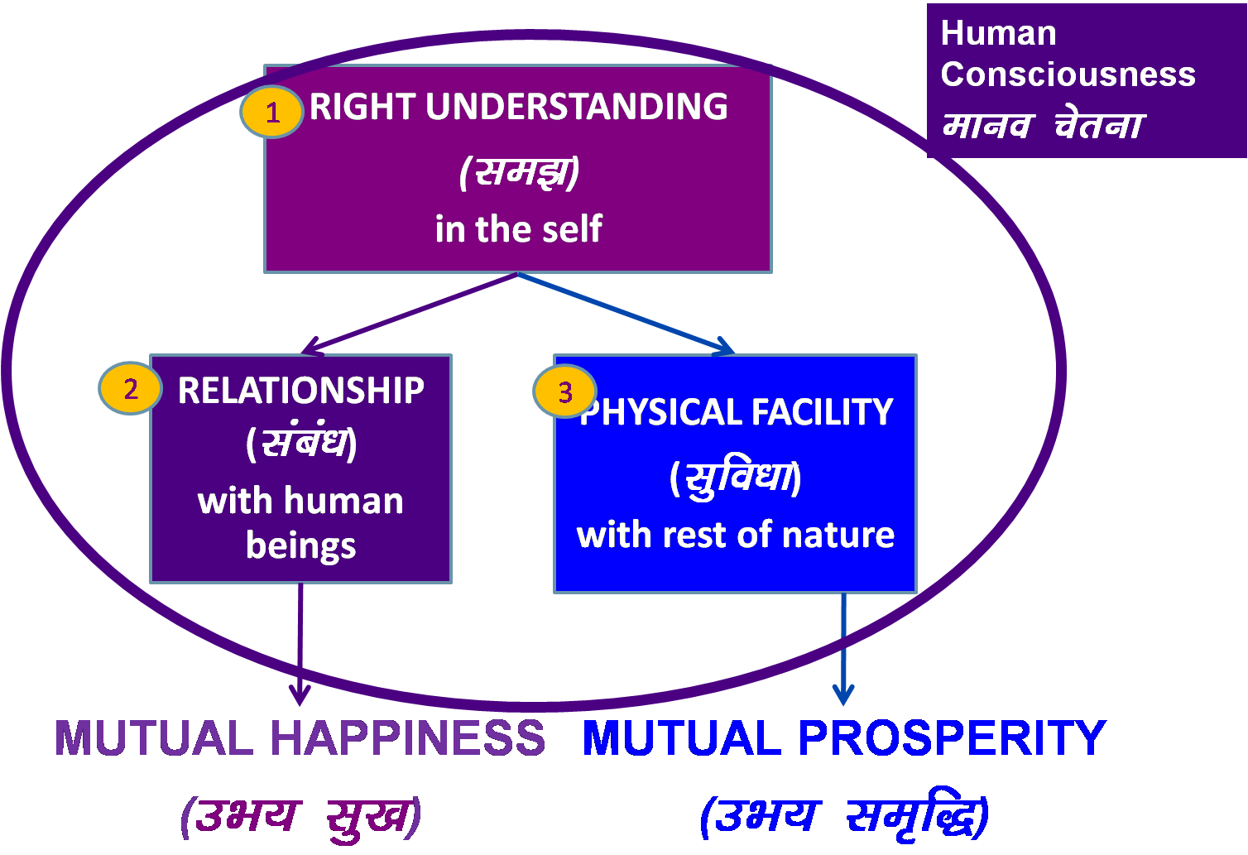
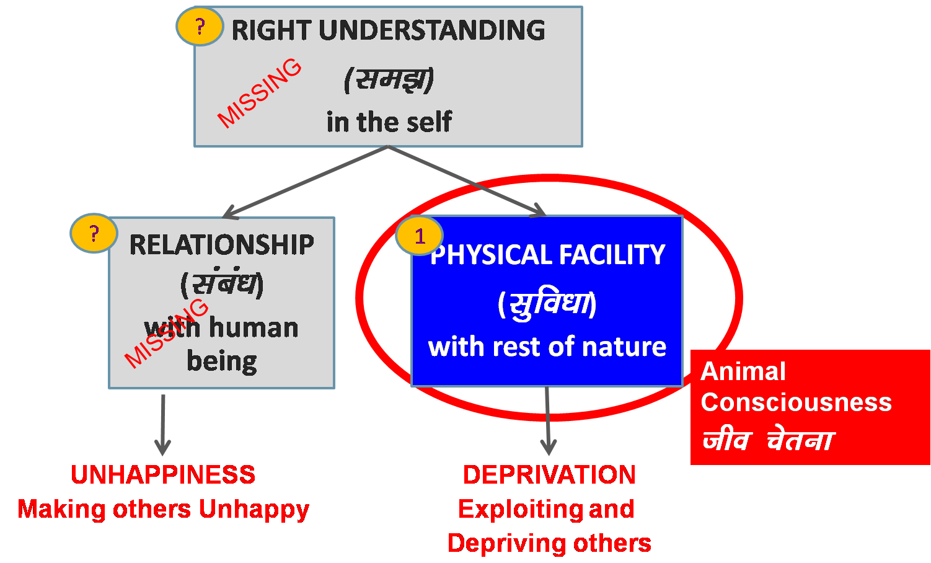
Role of Education – To Enable Transformation
Transformation& Progress
laØe.k&fodkl
Notes:
Is role education is just Good job?

Slide 6
Prevailing Notions of Happiness

Slide 7
Some Prevailing Notions of Happiness
Owning / accumulating physical facility
  For human being, physical facility is required, but it alone does not suffice for human being
Pleasure (from favourable sensation)
  Sound, Touch, Form, Taste, Smell – Through the Body
Tasty-Necessary → Tasty-Unnecessary → Tasteless-Unnecessary → Intolerable
Attention, appreciation… (favourable feelings) from others
  Dependence on the other, can’t be continuous
Sometimes “happiness”, excitement…
Sometimes “unhappiness”, depression…

Slide 8
Some Prevailing Means of Escape from Unhappiness, Depression
Over eating
Over sleeping
…
Gutka (Doma)
Alcohol
Drugs
…
Violence
…
Suicide

Slide 9
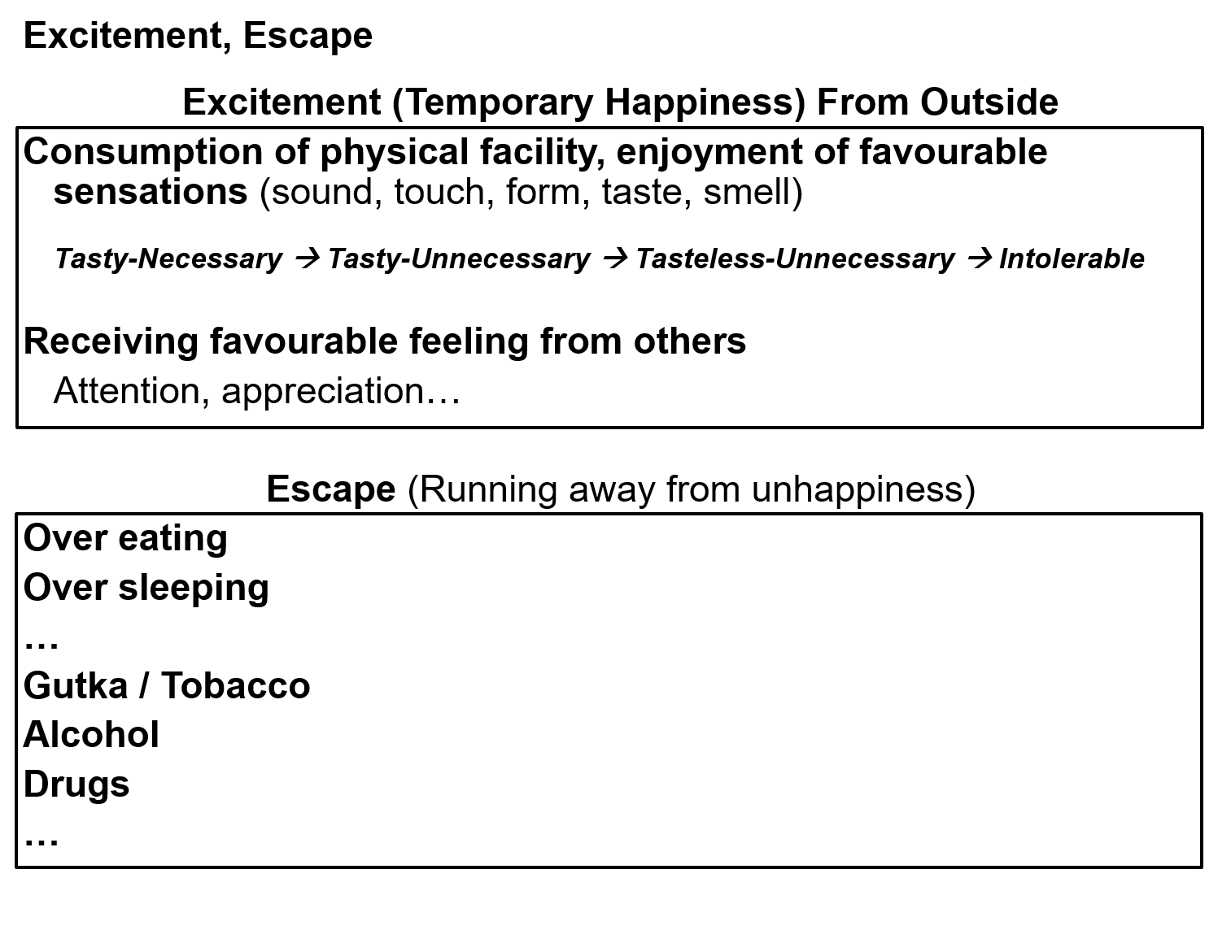
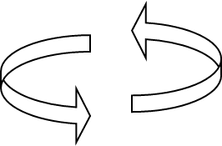
Excitement and Escape – Not Happiness
Temporary
Excitement
Animal Consciousness
Temporary
Escape from
Unhappiness

Slide 10
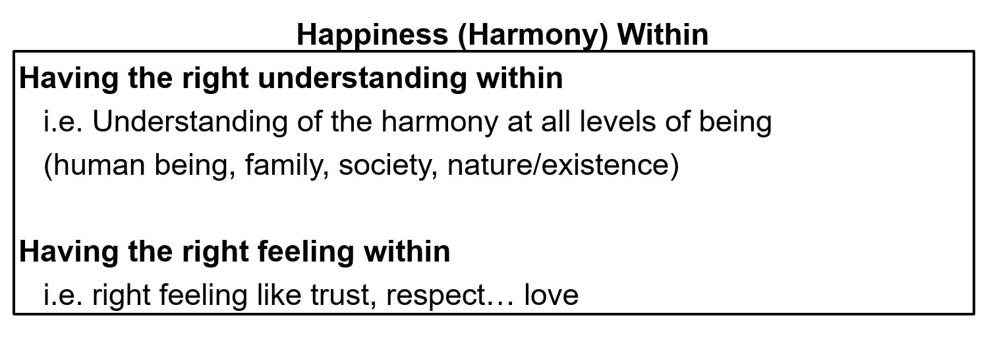
Continuous
Happiness
Human Consciousness
Transformation / Development
Temporary
Excitement
Animal Consciousness
Temporary
Escape from
Unhappiness

Slide 11
Sources of Happiness
Right Understanding
Harmony at all levels of being
Human Being, Family, Society, Nature/Existence
– in Self (I) Definite completion point, Continuity is possible, Self-organization (Swatantrata)
2. Right Feeling Trust, Respect, Affection, Care, Guidance,
Reverence, Glory, Gratitude, Love
– in Self (I) Definite completion point, Continuity is possible, Self-organization (Swatantrata)
– From Other Temporary, Dependence on Other,
No completion point, Continuity not possible
3. Sensation, PF Sound, Touch, Form, Taste, Smell
– Through Body Temporary, Dependence on Body & Other,
No completion point, Continuity not possible
Tasty-Necessary → Tasty-Unnecessary → Tasteless-Unnecessary → Intolerable

Slide 12
Happiness
To Be in Harmony

Slide 13
What is this Workshop / Course ;g f'kfOkj D;k gS
It is a process of dialogue – between me and you, to begin with
;g laokn dh izfØ;k gSA ;g laokn vkids vkSj esjs chp 'kq: gksrk gSA
2. It soon becomes a dialogue within your own Self…
“kh?kz gh ;g laokn vkids Lo;a eas pyus yxrk gSA

Slide 14
Happiness
1. We have to discover our natural acceptance
(where we want to reach)
What I Really Want to Be
My Natural Acceptance
My Intention
Always
Relationship
3. We have to ensure this dialog and ensure harmony within
(evaluate our desires vis-à-vis our natural acceptance)
These are in Contradiction
Unhappiness
These are in Harmony
Happiness
Dialogue
What I am
My Desire, Thought, Expectation…
My Competence
Sometimes
Opposition
Sometimes
Relationship
2. We have to find out what I am
(where we are now)

Slide 15
Happiness = Harmony Unhappiness = Disharmony
To have clarity, solution within
To be in harmony with family members
To be in harmony with the society
To be in harmony in nature/existence
= Happiness
To have confusion, problem within
To be in conflict with family members
To be in opposition with society
To struggle for survival
= Unhappiness

Slide 16
Happiness Unhappiness
The state or situation, in which I live,
if there is harmony / synergy in it,
then it is Naturally Acceptable to me to be in that state / situation
To be in a state / situation which is Naturally Acceptable is Happiness
To be in a state of Harmony / Synergy is Happiness
Happiness = To be in Harmony
The state or situation, in which I live,
if there is disharmony / contradiction in it,
then it is not Naturally Acceptable to me to be in that state / situation
To be forced to be in a state / situation which is not Naturally Acceptable is Unhappiness
To be forced to be in a state of Disharmony / Contradiction is Unhappiness
Unhappiness = Disharmony

Slide 17
Happiness Continuity of Happiness
The state or situation, in which I live,
if there is harmony / synergy in it,
then it is Naturally Acceptable to me to be in that state / situation
To be in a state / situation which is Naturally Acceptable is Happiness
To be in a state of Harmony / Synergy is Happiness
Happiness = To be in Harmony
State / Situation in which I live or expanse of my being:
  As an Individual Human Being
  As a member of a Family
  As a member of Society
  As an unit in Nature/Existence
Continuity of Happiness
= Harmony at all levels of being i.e.
  Harmony in the Human Being
  Harmony in the Family
  Harmony in the Society
  Harmony in Nature/Existence

Slide 18
Our Program
To facilitate understanding of the harmony at all levels of being
  Harmony in the Human Being
  Harmony in the Family
  Harmony in the Society
  Harmony in Nature/Existence
To understand & to live in harmony at all levels of being
  In the Human Being
  In the Family
  In the Society
  In Nature/Existence
Proposals
1
Verify the proposals
on the basis of your NATURAL ACCEPTANCE
b) Experiential validation
by LIVING ACCORDINGLY
2
Right Understanding
Right Feeling

Slide 19
Self Reflection

Slide 20
Home Work
Look within and find out if your perspective about happiness is based on assuming or it is based on knowing.
Find out if you have a need to understand harmony / refine your understanding of harmony

Slide 21
Perspective based on Assumptions (without Knowing)
Our perception (perspective) drives our thoughts, actions
Perception (one's view of the world – about self, others…)
Thoughts (depend on one's perception)
expression (depends on one's thoughts)
Actions
Without right understanding, our perspective is based on assumptions like:
  I am special
  The other is hell
  Money is everything…
Proposal

Slide 22
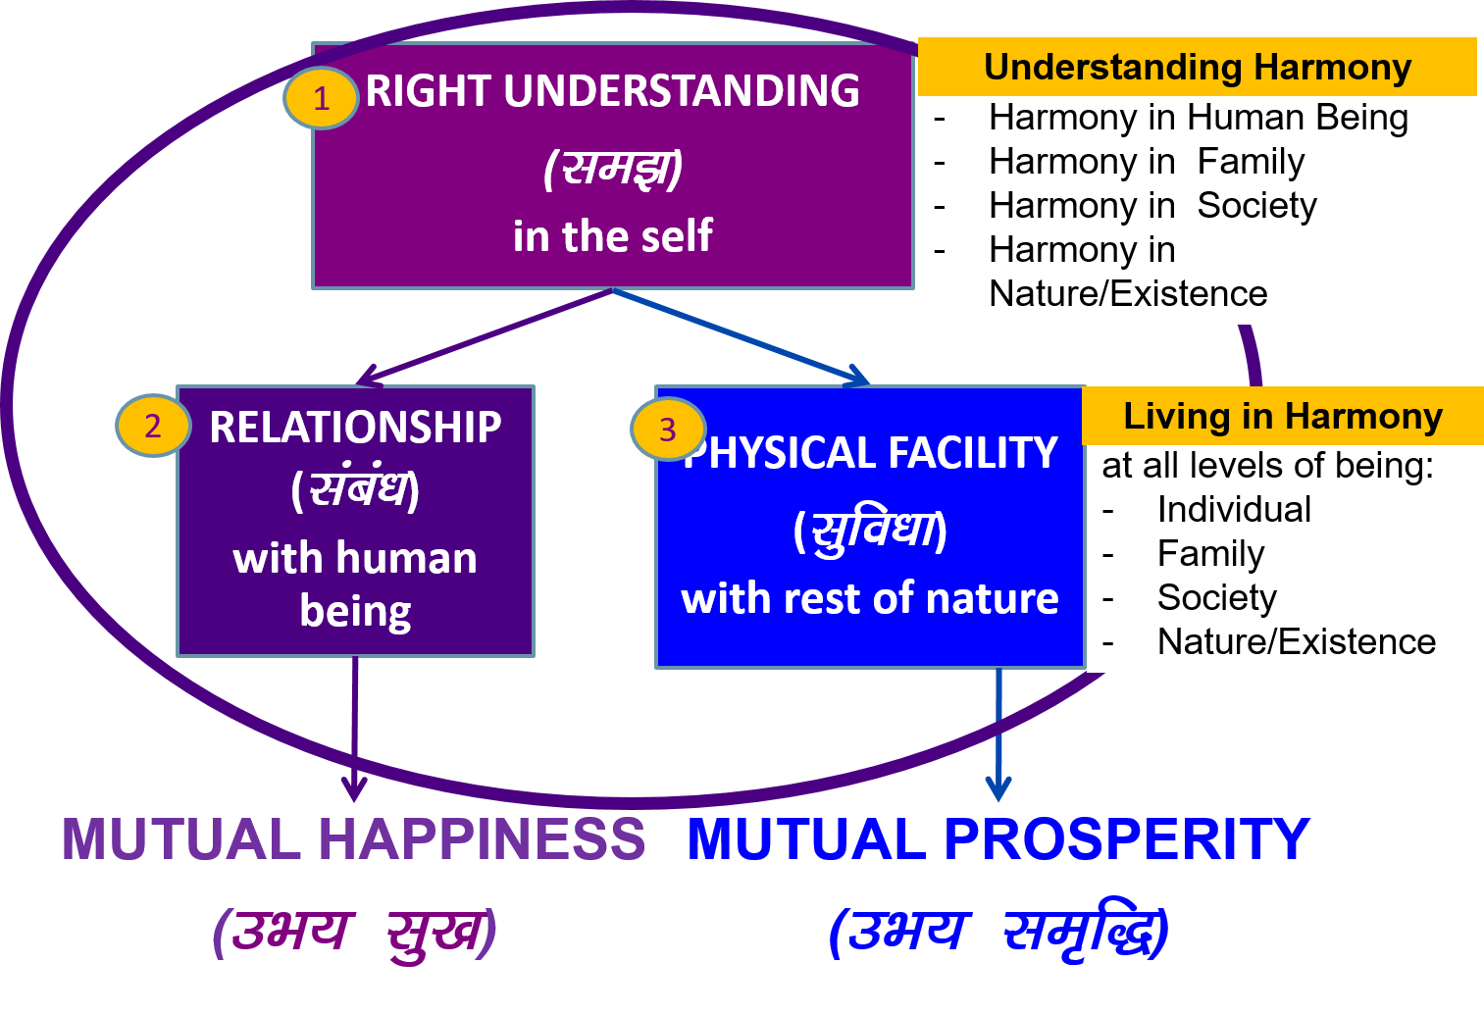
Holistic Perspective – based on Right Understanding
Our perception (perspective) drives our thoughts, actions
Perception (one's view of the world – about self, others…)
Thoughts (depend on one's perception)
expression (depends on one's thoughts)
Actions
We need to develop the right understanding (of harmony)
(and a holistic perspective based on it)
We need to develop the skills to live accordingly (in harmony)
Education is expected to facilitate in this process
Proposal

Slide 23
FAQ

Slide 24
FAQ
We have to follow social norms and live as per family traditions to be accepted in the society, or even in the family. This has been working for a long time. Do we need to verify these norms and traditions also?
What is the source of the proposals? If the source is verified, is authentic, then we can accept the proposals – and do we don’t need to verify them again. Right?
What we accept is something quite subjective, different things appeal to different people – How can we say that natural acceptance is same for everybody? Actually what is this natural acceptance?
How is it possible to understand everything by through the self? Just being aware of “what I am” and “what I really want to be” itself is so difficult.
Isn’t swatantrata and freedom the same? (please give examples of swatantrata at each level of being – individual, family, society and nature)

Slide 25
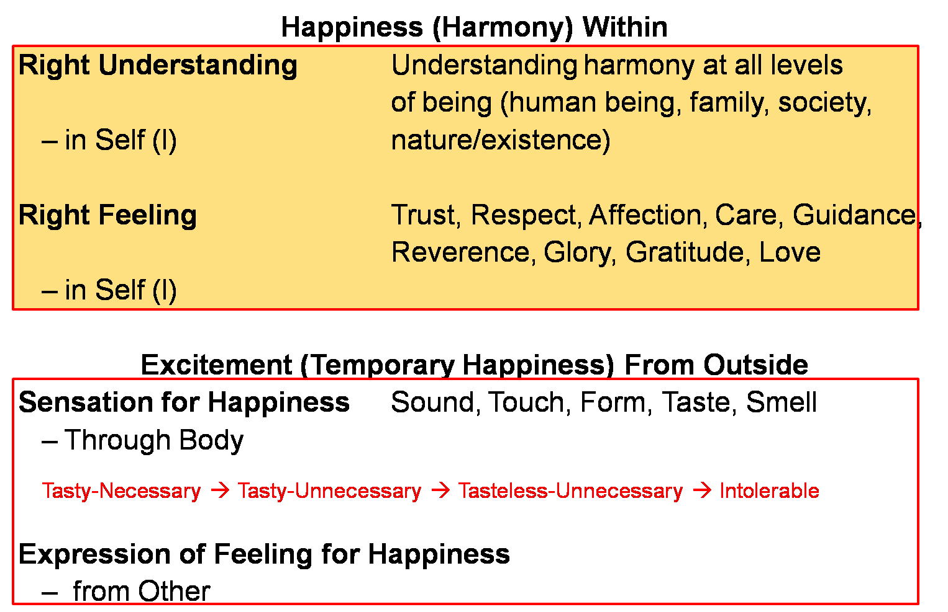

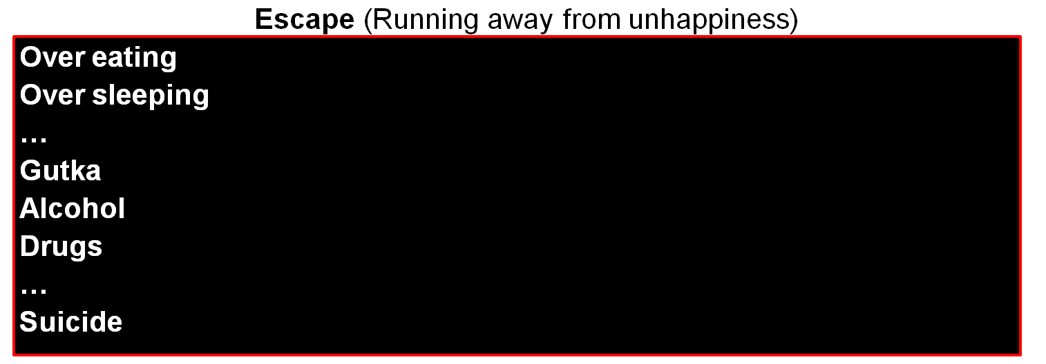
Realised
(Dorji)
Recovering
Addict
Addict

Slide 26
Happiness, Excitement, Escape
Happiness (Harmony) Within
Right Understanding Understanding harmony at all levels
of being (human being, family, society,
– in Self (I) nature/existence)
Right Feeling Trust, Respect, Affection, Care, Guidance,
Reverence, Glory, Gratitude, Love
– in Self (I)
Excitement (Temporary Happiness) From Outside
Sensation for Happiness Sound, Touch, Form, Taste, Smell
– Through Body
Tasty-Necessary → Tasty-Unnecessary → Tasteless-Unnecessary → Intolerable
Expression of Feeling for Happiness
– from Other

Slide 27
Happiness, Excitement, Escape
Escape (Running away from unhappiness)
Over eating
Over sleeping
…
Gutka
Alcohol
Drugs
…
Suicide

